Slide 1

IBM Data Analyst Capstone: A Look Into Technological Skills
Tamir El-Waleed
05/05/2024

Slide 2

OUTLINE
Executive Summary
Introduction
Methodology
Results
Visualization – Charts
Dashboard
Discussion
Findings & Implications
Conclusion
Appendix

Slide 3

EXECUTIVE SUMMARY
In order to keep pace with changing technologies and remain competitive, data is regularly analyzed to help identify future skill requirements.
Data was collected through surveys, job postings & training portals, and then was analyzed and visualized through dashboards.
Findings have shown multiple trends, including the outstanding popularity of Javascript, SQL dialects in general and that young males are the predominant demographic in the tech field

Slide 4

INTRODUCTION
This project investigates the technologies and skills in the tech field, and answer the following questions:
What are the top programming languages in demand?
What are the top database skills in demand?
What are the popular IDEs?
This research is targeted towards people working in or interested in the tech field

Slide 5

METHODOLOGY
Data Collecting was done from multiple sources namely: Surveys, Job Postings & Training Portals
Data was imported by:
API’s
Web Scraping
The main programming languages used: Python and SQL through sqlite3
Data cleaning and wrangling was done through python libraries
EDA (Exploratory Data Analysis) was also carried out.
Visualizations were created using Python, and the final dashboards were created through IBM Cognos

Slide 6
RESULTS

Slide 7
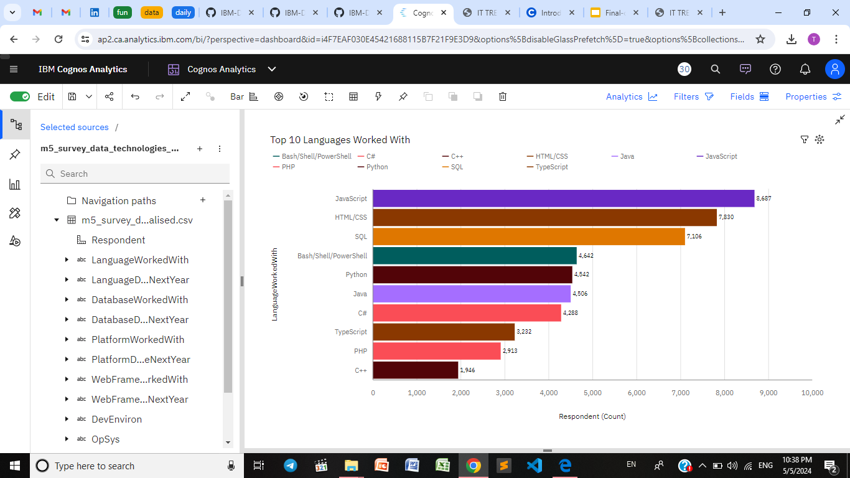
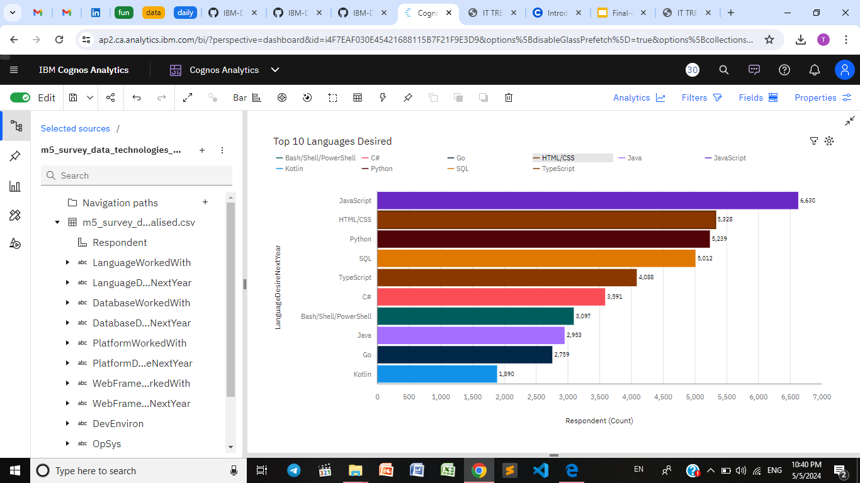
PROGRAMMING LANGUAGE TRENDS

Slide 8
PROGRAMMING LANGUAGE TRENDS - FINDINGS & IMPLICATIONS
Findings
Javascript & HTML/CSS are and will remain popular
Python & Typescript are expected to to increase in popularity
Languages like Go & Kotlin might witness a great rise too.
Implications
The essentiality of python and typescript in the future job market.

Slide 9
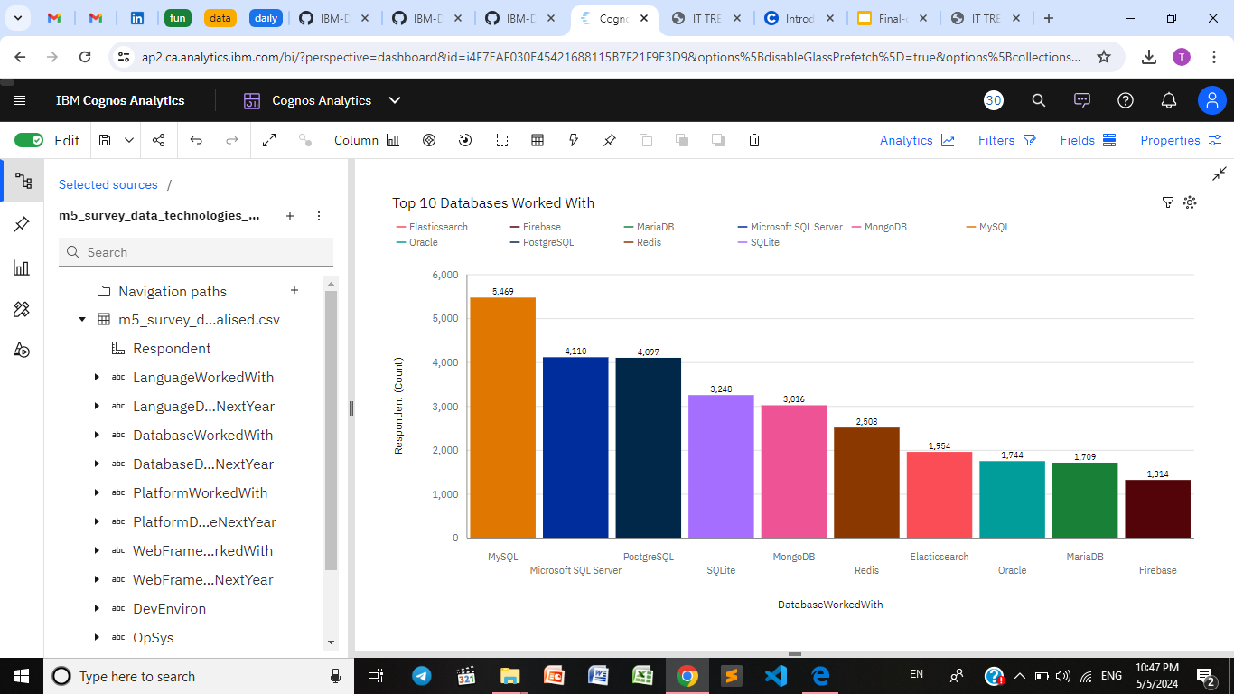
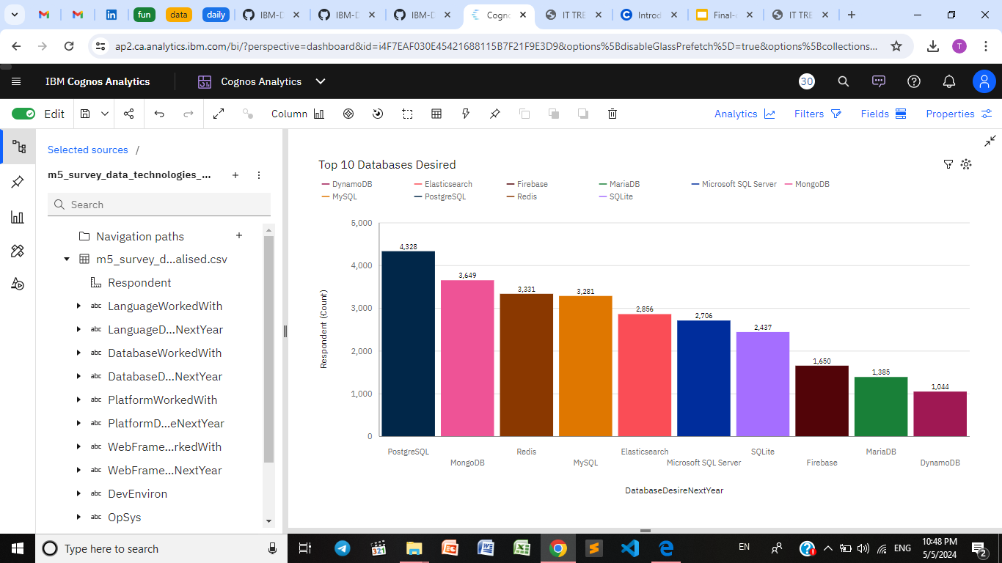
DATABASE TRENDS

Slide 10
DATABASE TRENDS - FINDINGS & IMPLICATIONS
Findings
Current popularity of MySQL might be overtaken by PostGRE
Redis is also experiencing a popularity rise as well as MongoDB
Finding 3
Implications
Microsoft SQL and mySQL will eventually lose demand in the market
Whereas MongoDB and Redis will become cornerstones of the market

Slide 11

DASHBOARD
https://github.com/tamirwaleed/IBM-Data-Analyst-Capstone/blob/main/7.%20Dashboards.pdf

Slide 12
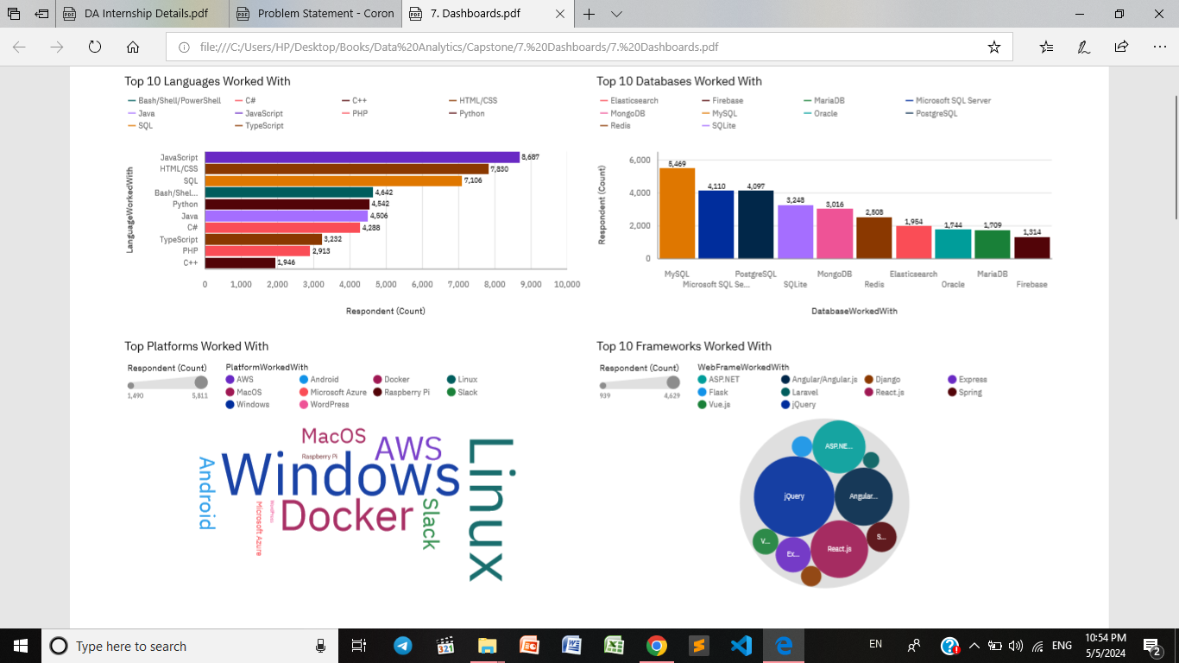
DASHBOARD TAB (Current)
Screenshot of dashboard tab 1 goes here

Slide 13
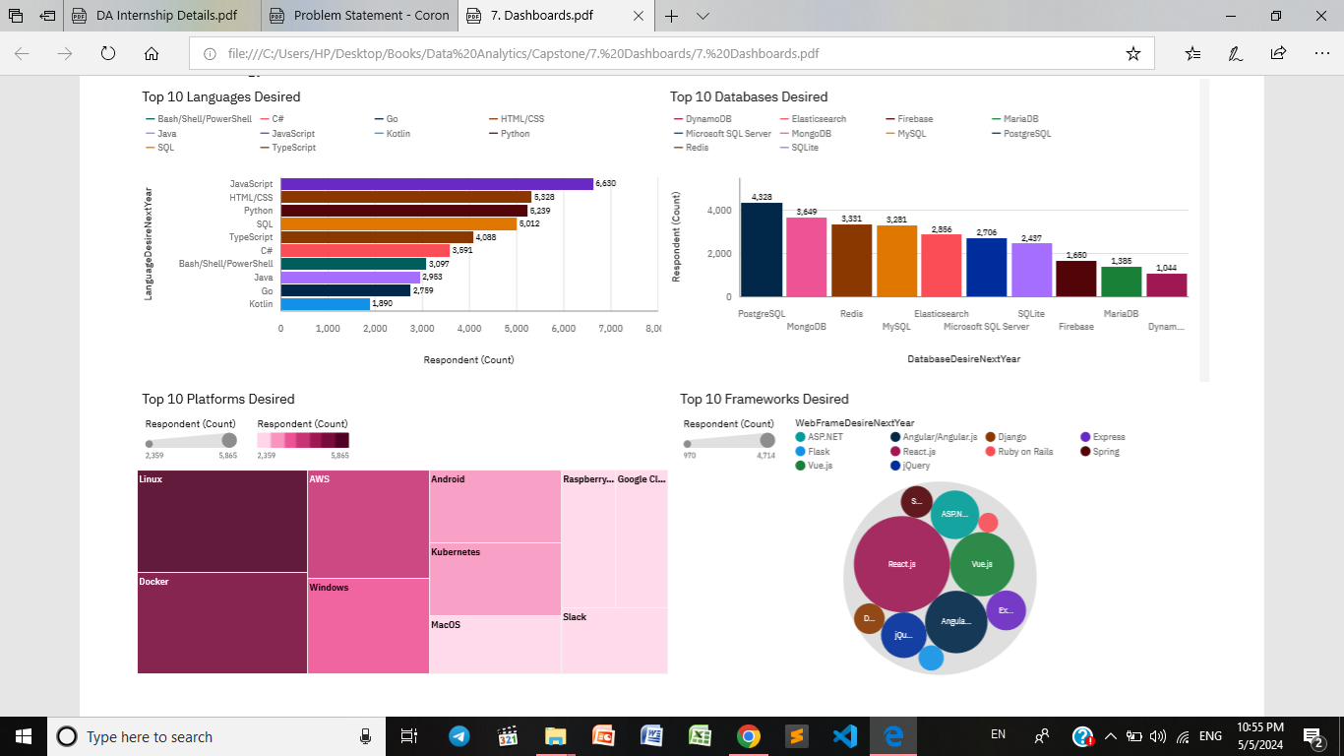
DASHBOARD TAB (Future)

Slide 14
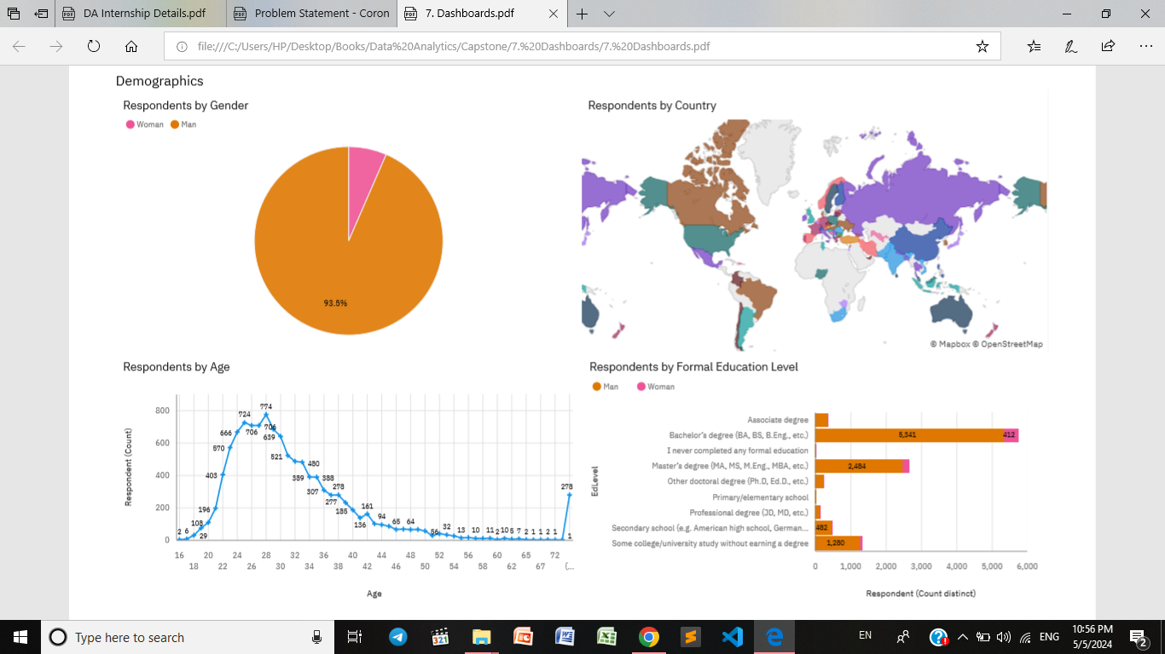
DASHBOARD TAB (Demographics)

Slide 15
DISCUSSION

Slide 16
OVERALL FINDINGS & IMPLICATIONS
Findings
Javascript, HTML/CSS popularity
Young male predominance of the field
No post grads usually in the field
Developed Countries are the main tech-hubs
Popularity of SQL with its different dialects
The fast-rise of Python, typescript, Redis and MongoDB
Implications
Less developed countries need more outreach as to be involved in the field
The Gender gap needs to be reduced

Slide 17

CONCLUSION
Focus needs to be shifted towards the growing skills in order to be as up-to-date as possible
Expanding into the female demographic and less developed countries to find the hidden talents.
Providing post-grad scholarships will help to attract more developers.

Slide 18

APPENDIX

Slide 19
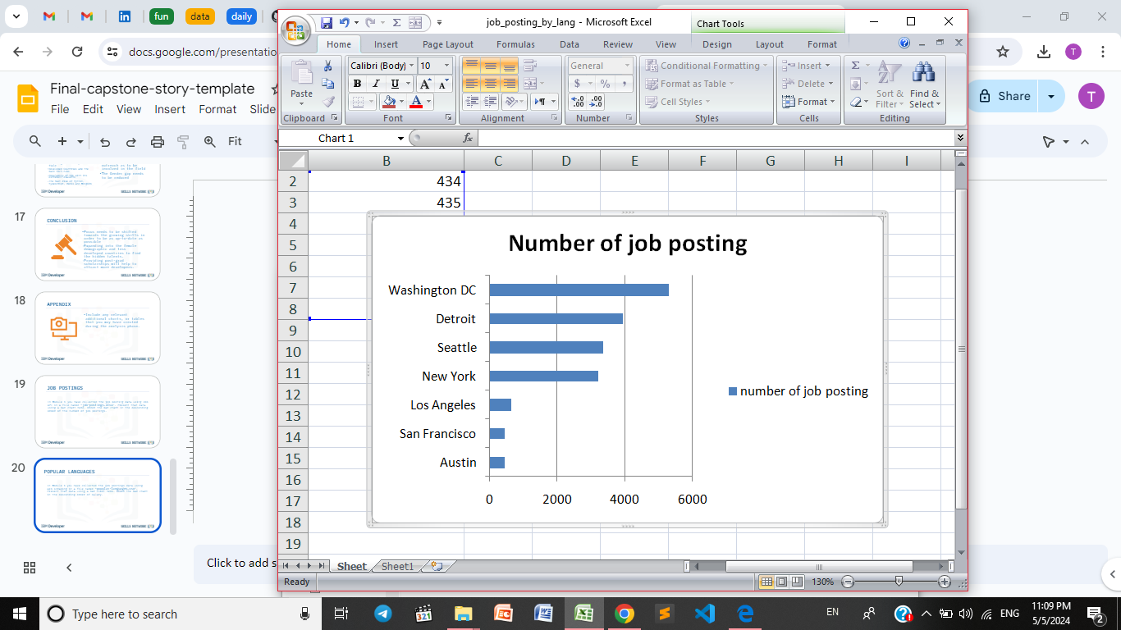
JOB POSTINGS

Slide 20
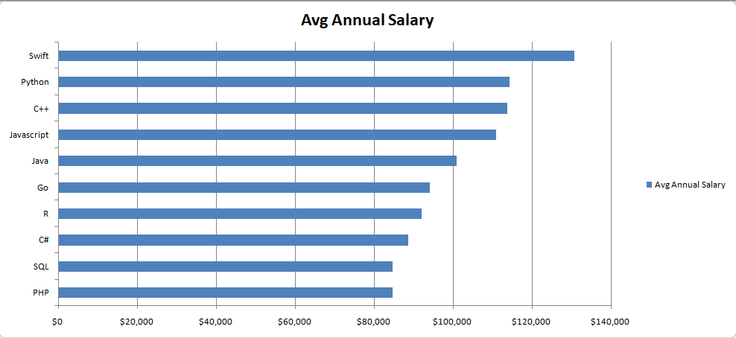
POPULAR LANGUAGES
In Module 1 you have collected the job postings data using web scraping in a file named “popular-languages.csv”. Present that data using a bar chart here. Order the bar chart in the descending order of salary.

